Slide 1
Concurrent Depth-First Search Algorithms
Mohamad Alsabbagh
Department of Electrical Engineering and Computer Science
York University, Toronto
October 8, 2015

Slide 2
Problems Tarjan’s algorithms solve
Tarjan's Algorithms solve three related problems relevant to model checking. Given a state graph;
Find its Strongly Connected Components (SCCs)
Identify which nodes are in a loop
Locate which nodes are in a lasso
Notes:
(FDR3). FDR checks refinement for formal models expressed in CSP (communicating sequential processes). CSP is a formal language to define concurrent systems and their interaction between each other by communication.
Finding loops has applications in linear temporal logic (LTL) model checking

Slide 3
Why are these problems important?
Lassos: FDR or failure-divergence refinement.
SCCs: useful for performing compression on the transition graphs.
Loops: important in linear temporal logic (LTL) model checking.
Notes:
(FDR3). FDR checks refinement for formal models expressed in CSP (communicating sequential processes). CSP is a formal language to define concurrent systems and their interaction between each other by communication.

Slide 4
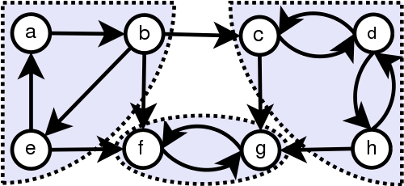
Strongly Connected Components
A directed subgraph that satisfy Strongly Connected attribute.

Slide 5
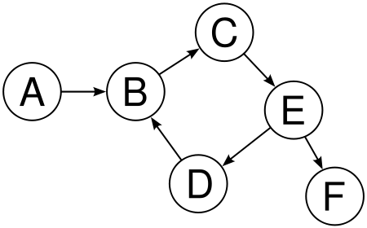
Loops & Lassos
Loop: a node is part of a direct cycle
Lasso: a path from a node to a node on a cycle

Slide 6
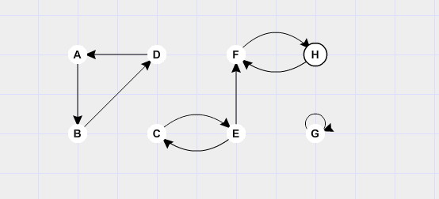
Sequential Tarjan's Algorithm
Depth-First Search to identify SCCs.

Slide 7
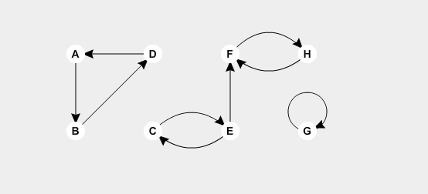
Concurrent Tarjan's Algorithm
A single concurrent version of Tarjan’s algorithm to identify SCCs

Slide 8
Tarjan's Node Structure
Each node in the graph G has the following attributes:
index (sequential and concurrent):
  which is a sequence counter, corresponding to the order in which nodes were encountered
lowlink (sequential and concurrent):
  which records the smallest index of a node n′ in the stack that is reachable via the descendents of n fully considered so far
search (concurrent):
  identifying which search a node belongs to

Slide 9
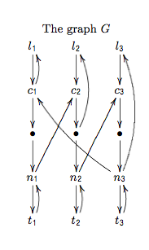
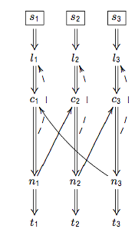
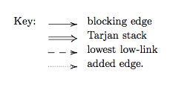
Circular Dependency

Slide 10
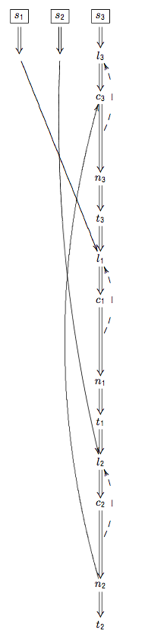
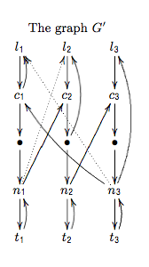
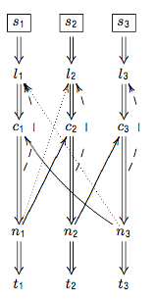
Circular Dependency Node Transfer

Slide 11
Circular Dependency Node Transfer
When transferring a node from s₁ to s₃ we will need to recalculate its index amd lowlink values:
δ₁ = (s₃.index − l₁.index)
we add δ₁ onto the index and lowlink of each node transferred from s₁ and update.

Slide 12
Next Steps
Plan:
implement all three algorithms
compare their performance

Slide 13
Q&A
Thanks

